Slide 1


K.RAMAKRISHNAN COLLEGE OF TECHNOLOGY
(AUTONOMOUS), TRICHY.
ONLINE JOB PORTAL
PRESENTED BY
ELUMALAI . S
2303811710421039
SUPERVISOR
Mr. M. Saravanan, M.E.,
AP/CSE.

Slide 2
PRESENTATION OVERVIEW
Objective
Project Introduction
Problem Statement
Methodologies (Programming concepts relevant to problem statement)
Architecture of the proposed system
List of Modules
Merits
Results and Discussion
Queries

Slide 3
OBJECTIVE
The Online Job Portal System is designed to bridge the gap between job seekers and employers.
By providing a user-friendly platform to facilitate efficient job matching and recruitment processes.

Slide 4
PROJECT INTRODUCTION
The Online Job Portal System is a software application designed to connect job seekers with employers.
With the increasing demand for digital platforms in the employment sector.
This system provides an efficient, easy-to-use solution for both parties.

Slide 5
PROBLEM STATEMENT
Job seekers face difficulty finding relevant opportunities.
Employers struggle to connect with qualified candidates.
Inefficient job search and application processes.

Slide 6
METHODOLOGIES
User Verification Module : This module identifies whether the user is an Employer or a Job Seeker and directs them to the appropriate functionality.
Job Posting Module : This module allows employers to post job vacancies by providing details such as title, type, domain, description, and salary package.
Job Searching Module : This module allows job seekers to search for jobs based on their selected domain of interest.
Application Module : This module handles the job application process, where job seekers provide their personal details to apply for a selected job.

Slide 7
ARCHITECTURE OF THE PROPOSED SYSTEM
ONLINE JOB PORTAL
JOB SEEKER
EMPLOYER
APPLY FOR JOB
POST JOB OFFER

Slide 8
LIST OF MODULES
1. User Verification Module
2. Job Posting Module
3. Job Searching Module
4. Application Module

Slide 9
MERITS
Convenience and Accessibility: Job seekers can apply for jobs anytime and anywhere with an internet connection.
Wide Range of Opportunities: Access to diverse job openings across industries and locations, often with filters to narrow down relevant roles.
Profile Customization: Users can create profiles, upload resumes, and showcase skills and qualifications in a standardized format.

Slide 10

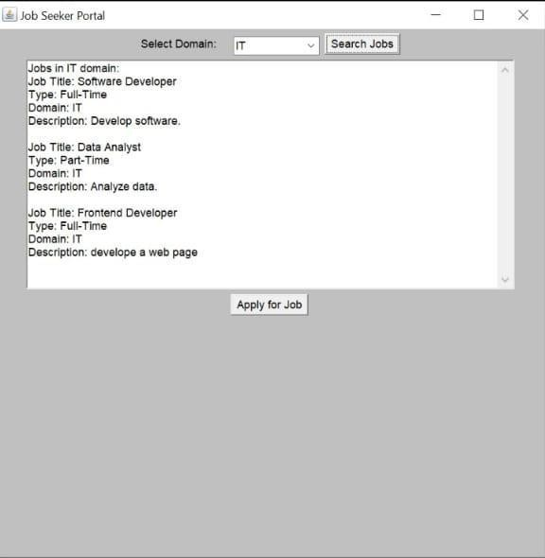
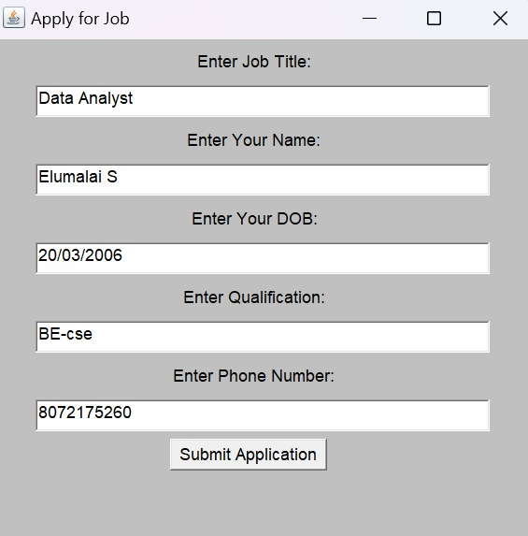

RESULTS AND DISCUSSION

Slide 11
QUERIES ?

